Slide 1
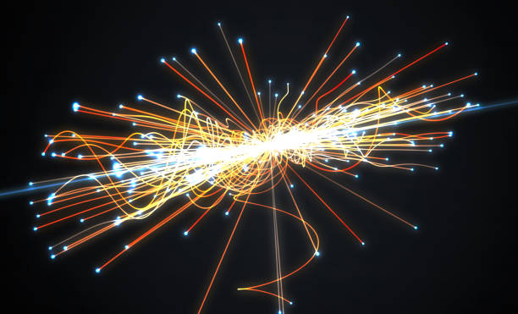
Toy Monte Carlo: Dimuon Decay
Department of physics, NCKU
Chao Tsung Wu
Yi Yang
Date : 2021/07/05

Slide 2
Toy Monte Carlo
Monte Carlo method : a computational algorithm use randomness to solve problems that might be deterministic in principle.
We use it to simulate the process during particle scattering from the high energy collision statistically.
I analysis the data (analogy with the process of muons decay from specific particle after the collision) constructed by some random variables obeys some particular distributions.

Slide 3


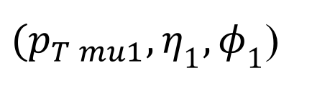
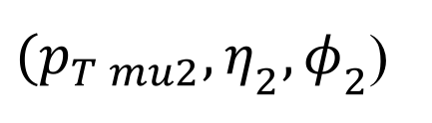
Toy Monte Carlo
Here, a “event” is defined by each unknown (for me) mass particle decays into two muons.
$$μ_{1}$$
${(p}_{T mu1},η_{1},φ_{1}$)
Dimuon pairs
X
$$μ_{2}$$
${(p}_{T mu2},η_{2},φ_{2}$)
Goals
Goals
Find out the unknown mass particle
Plot $p_{T}$ distribution of
pure signal
Plot 𝑝_𝑇 distribution of
pure signal

Slide 4
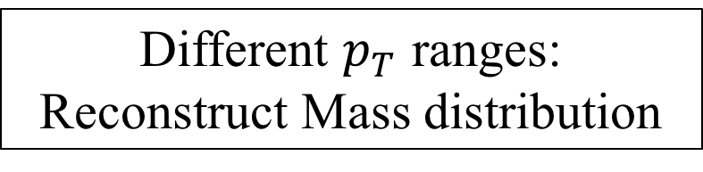
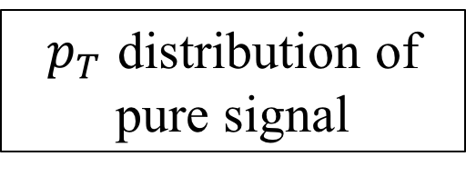
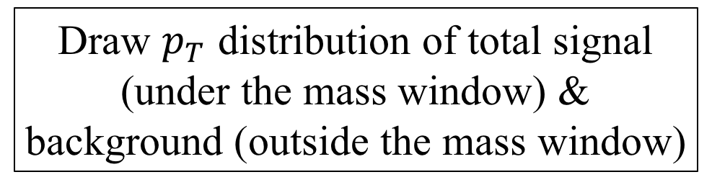
Toy Monte Carlo : Steps
Reconstruct Mass distribution
Find out the unknown mass particle
Fitting
Get the mass window
Sideband Subtraction
Fitting Method
Draw $p_{T}$ distribution of total signal (under the mass window) & background (outside the mass window)
Different $p_{T}$ ranges:
Reconstruct Mass distribution
Fitting
$p_{T}$ distribution of pure signal

Slide 5
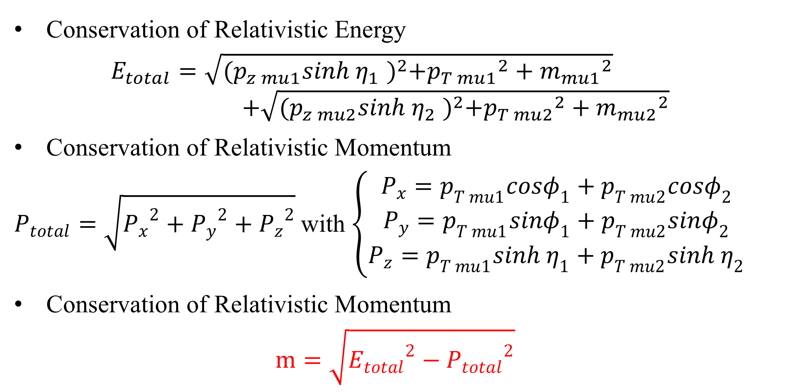
Reconstruct Mass Distribution
Conservation of Relativistic Energy
$$E_{total}=\sqrt{{\text{(}p_{z mu1}sinh η_{1} )}^{2}+{p_{T mu1}}^{2}+{m_{mu1}}^{2}}$$
$$+\sqrt{{\text{(}p_{z mu2}sinh η_{2} )}^{2}+{p_{T mu2}}^{2}+{m_{mu2}}^{2}}$$
Conservation of Relativistic Momentum
$P_{total}=\sqrt{{P_{x}}^{2}+{P_{y}}^{2}+{P_{z}}^{2}}$ with $\left\{\begin{aligned}P_{x}=p_{T mu1}cosφ_{1}+p_{T mu2}cosφ_{2} \\ P_{y}=p_{T mu1}sinφ_{1}+p_{T mu2}sinφ_{2} \\ P_{z}=p_{T mu1}sinh η_{1}+p_{T mu2}sinh η_{2}\end{aligned}\right.$
Conservation of Relativistic Momentum
$$m=\sqrt{{E_{total}}^{2}−{P_{total}}^{2}}$$

Slide 6
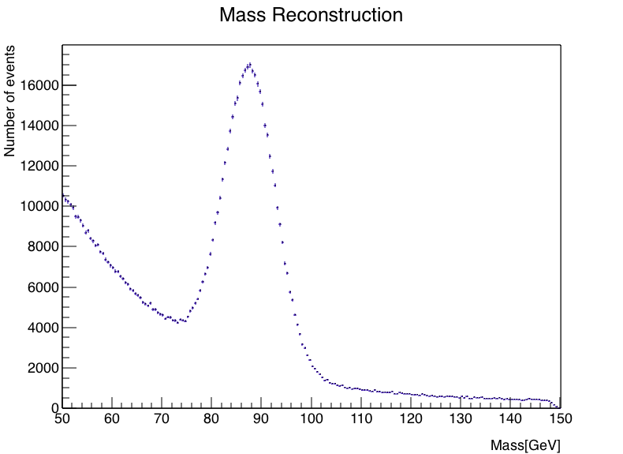
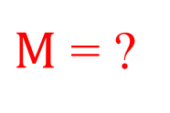
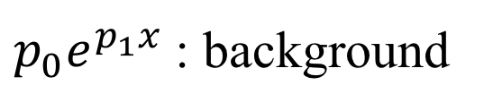
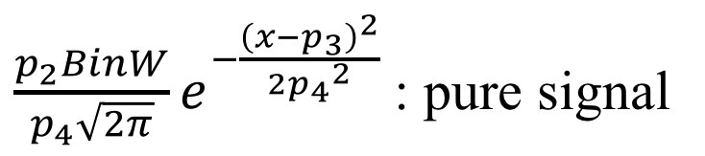
The Results of Mass Distribution
$\frac{p_{2}BinW}{p_{4}\sqrt{2π}}e^{−\frac{{\left(x−p_{3}\right)}^{2}}{2{p_{4}}^{2}}}$ : pure signal
$p_{0}e^{p_{1}x}$ : background
X
$M$ = ?

Slide 7
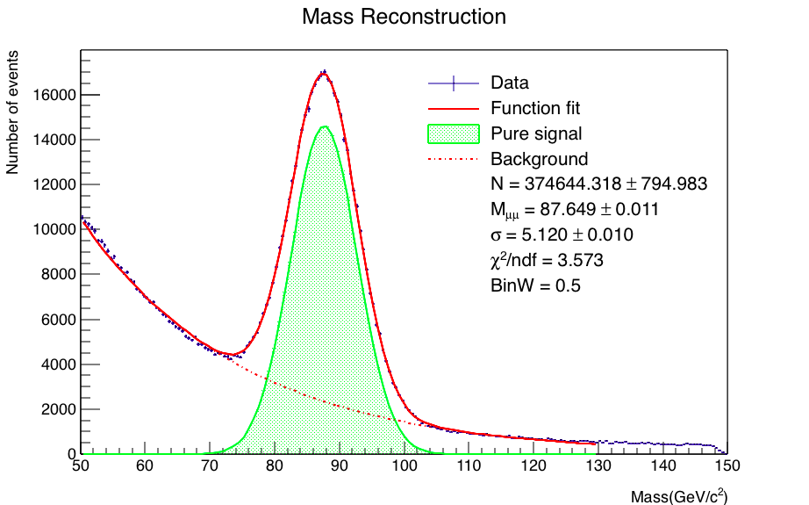
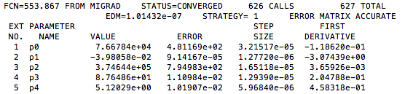
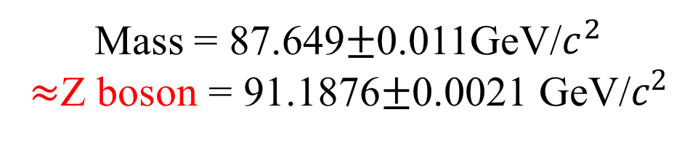
Fitting
Mass = 87.649$±$0.011GeV/$c^{2}$
$≈$Z boson = 91.1876$±$0.0021 GeV/$c^{2}$

Slide 8
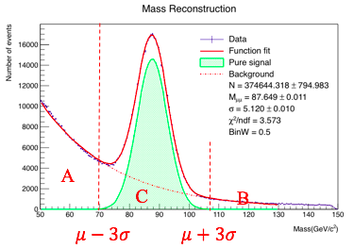
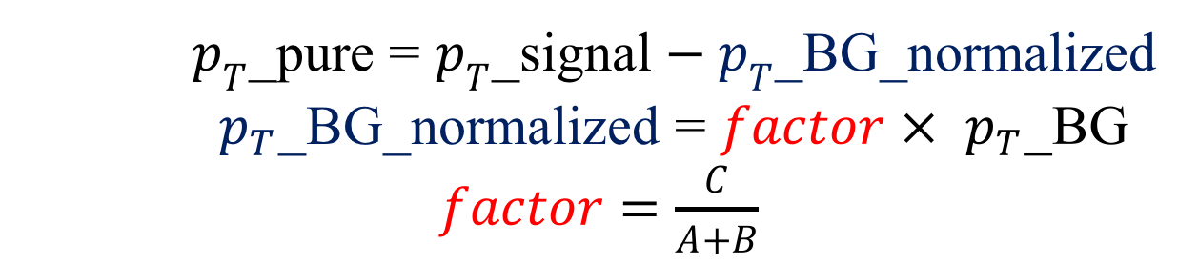
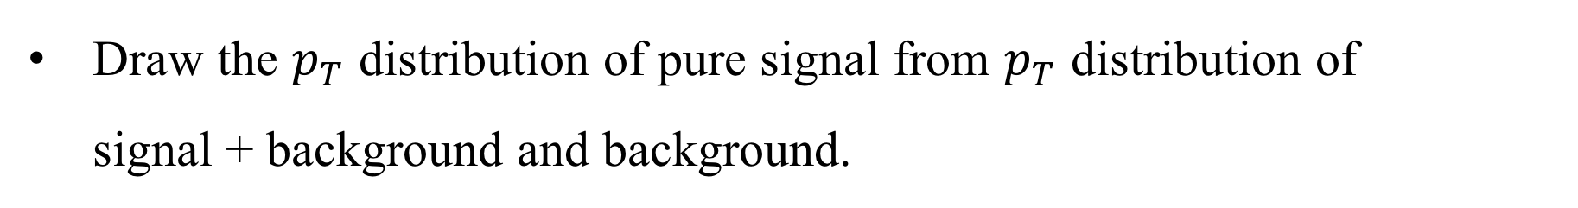
Sideband Subtraction
Draw the $p_{T}$ distribution of pure signal from $p_{T}$ distribution of signal + background and background.
$p_{T}$_pure = $p_{T}$_signal$− p_{T}$_BG_normalized
$p_{T}$_BG_normalized = $factor × p_{T}\text{_}\text{BG}$
$factor=$ $\frac{C}{A+B}$

Slide 9
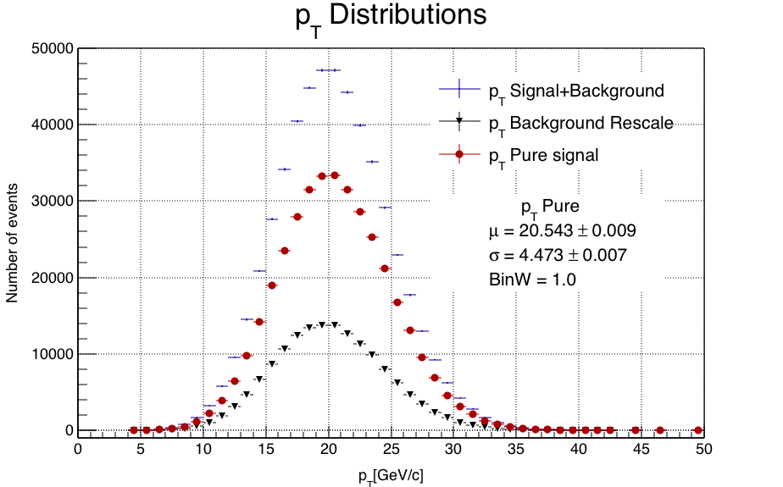
The Results of Sideband Subtraction

Slide 10
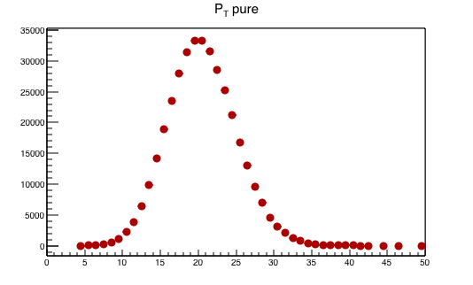
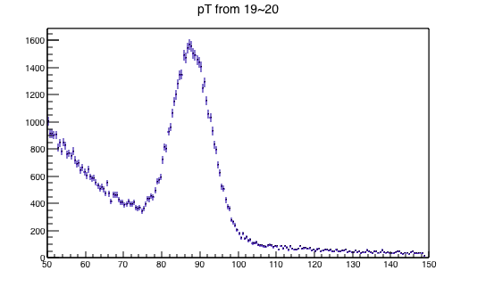
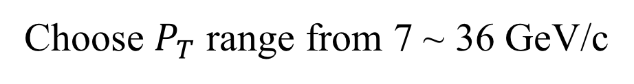
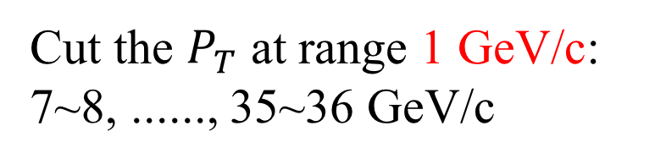
Fitting Method
Cut the $P_{T}$ at range 1 GeV/c:
7~8, ......, 35~36 GeV/c
Choose $P_{T}$ range from 7 ~ 36 GeV/c
Mass distributions

Slide 11
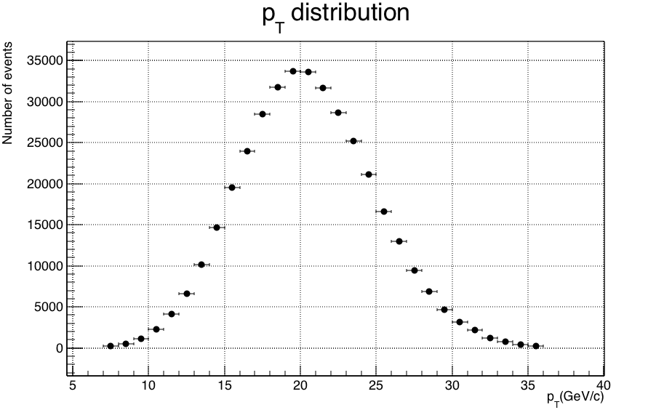
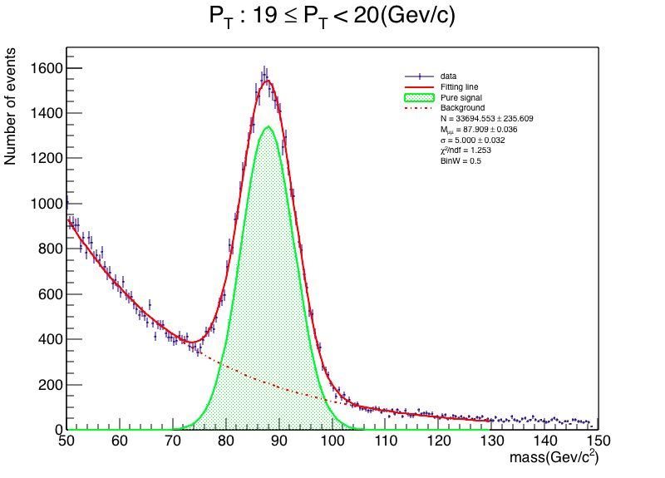
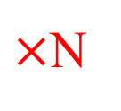
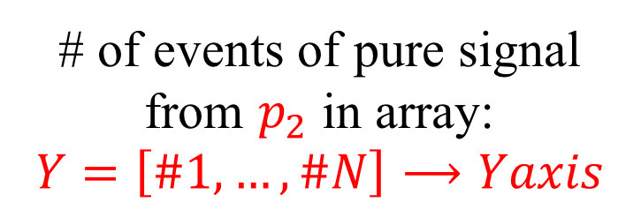
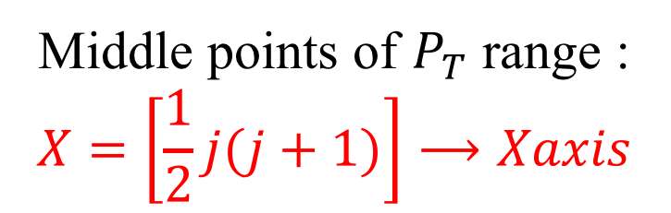
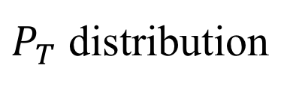
Fitting Method
$P_{T}$ distribution
Fittings
$×$N
# of events of pure signal from $p_{2}$ in array:
$$Y=\left[\#1,…,\#N\right]⟶Yaxis$$
Middle points of $P_{T}$ range :
$$X=\left[\frac{1}{2}j(j+1)\right]⟶Xaxis$$

Slide 12
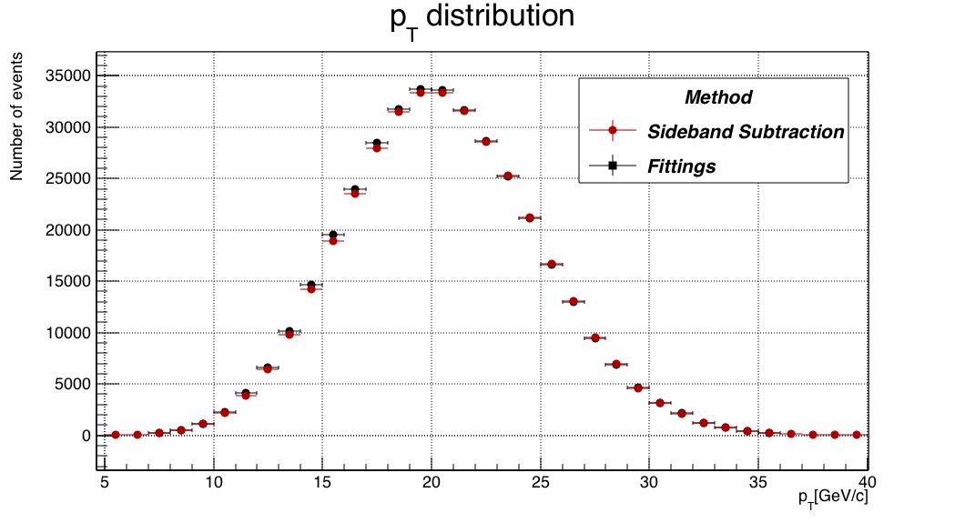
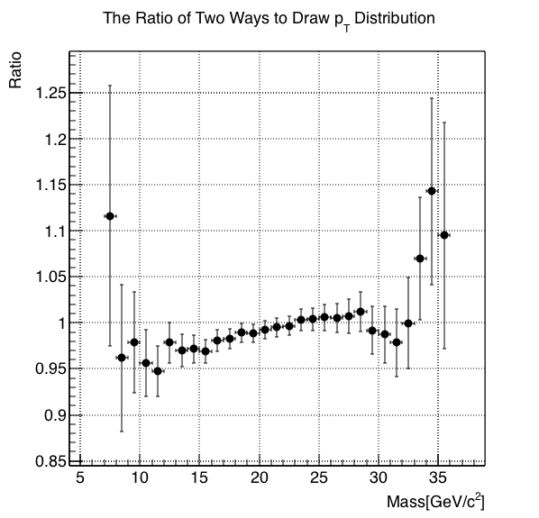
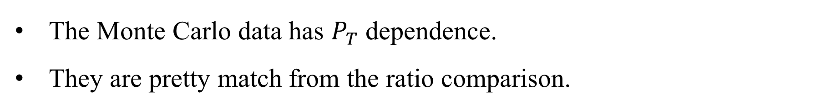
Comparing Two Results of Methods
The Monte Carlo data has $P_{T}$ dependence.
They are pretty match from the ratio comparison.

